Slide 1
Pharmacy First Service Summary slides from contractor information evenings 16th, 17th and 24th January 2024

Slide 2
Agenda for the evening
Chair’s introduction to the evening
Pharmacy First Service Overview
Tips to stretch your workforce and Making Every Contact Count (MECC)
Patient journey through the UTI conditions pathway
Key dates & Resources
Q&A - All
Close

Slide 3
Pharmacy First Service Overview Strategic context for the service​ Summary of the service requirements​ The clinical pathways and PGDs​ Learning and development requirements​ Preparing to provide the service​ Q&A

Slide 4
The Pharmacy First service
Community Pharmacy England submitted proposals for a Pharmacy First service to DHSC and NHSE in March 2022​
This was followed up with a comms and lobbying campaign​
On 9th May 2023, DHSC and NHSE published the Delivery plan for recovering access to primary care​
This included a commitment to commission a Pharmacy First service, allowing the treatment of seven conditions​
The start date is 31st January 2024 (subject to IT support being available)

Slide 5
Pharmacy First will be a new Advanced service that will include seven new clinical pathways and will replace the Community Pharmacist Consultation Service (CPCS)
The service will consist of three elements:
Clinical pathway consultations
New element
Urgent supply of repeat meds and appliances
Previously part of CPCS
Referrals for minor illness consultations
Previously part of CPCS

Slide 6
What are the seven conditions?
Sinusitis
12 years and over
Sore throat
5 years and over
Acute otitis media
1 to 17 years
Infected insect bite
1 year and over
Impetigo
1 year and over
Shingles
18 years and over
Uncomplicated UTI
Women 16 to 64 years

Slide 7
The Pharmacy First service
Pharmacies opting-in must provide all three elements of the new service
Patients can present to the pharmacy for clinical pathways consultations (only)
Clinical pathways consultations can be provided remotely, except for the acute otitis media pathway (otoscope required)
Remote consultations must be via high-quality video link
DSPs can only provide clinical pathways consultations remotely (due to the link to Essential services)
They cannot provide the acute otitis media pathway (otoscope required)
There are no changes to the former CPCS elements of the service, e.g. referrals are still required and telephone consultations are still possible, where clinically appropriate

Slide 8
Summary of the service requirements

Slide 9
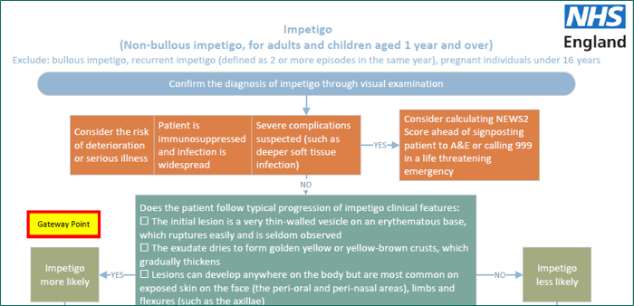
Clinical pathways consultations
Service spec and seven clinical pathways developed
23 associated PGDs and one clinical protocol (P med)
The clinical pathways contain one or more Gateway points
For a patient to be eligible to receive a clinical pathways consultation, a Gateway point must be passed

Slide 10
High-level service overview
Referral
Patient presents to the pharmacy
Gateway
met
Urgent repeat meds referral
Minor illness referral
Clinical pathway referral
Gateway
met
Gateway
not met
Gateway
not met
Urgent repeat meds consultation
Minor illness consultation
Clinical pathway consultation
Self-care Essential service
A more detailed service pathway diagram can be found in Annex A of the service spec

Slide 11
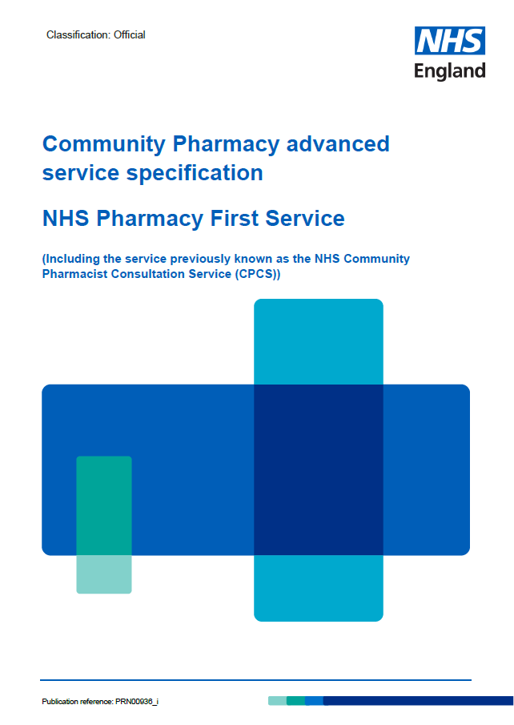
The service requirements
Complying with Terms of Service requirements for Essential services and clinical governance​
Have a consultation room meeting the ToS requirements, with access to IT equipment for record keeping​
Equipment – otoscope – see buying advice in Annex C​
Standard operating procedure, including the process for escalation​
Competency and training requirements​
Have an NHS-assured clinical IT system​ (Provider Pays)
Sign-up to provide the service on MYS​
Where supplies of an NHS medicine are made, the normal prescription charge rules apply

Slide 12
Funding
Funding for the clinical pathways consultations comes from the additional £645m provided to support the recovery plan
Initial fixed payment of £2,000
Must sign-up to provide the service on MYS by 11.59pm on 30th January 2024
The payment will be reclaimed if 5 clinical pathways consultations are not provided by the end of March 2024
£15 fee per completed consultation (also applies to CPCS consultations from 1st Jan 2024)

Slide 13
Funding
Month | Minimum number of clinical pathways consultations
February 2024 | 1
March 2024 | 5
April 2024 | 5
May 2024 | 10
June 2024 | 10
July 2024 | 10
August 2024 | 20
September 2024 | 20
October 2024 onwards | 30
A monthly fixed payment of £1,000 where the pharmacy meets a minimum number of clinical pathways consultations:
From April 2024, an initial cap of 3,000 consultations per month per pharmacy will be put in place
From October 2024, new caps will be introduced based on actual provision of clinical pathway consultations, designed to deliver 3 million consultations per quarter
Clearly demonstrates an expectation of an average of100 per pharmacy a month – anything less and there is a real risk the Treasury will pull the plug

Slide 14
The clinical pathways and PGDs

Slide 15
Clinical pathway consultations
The clinical pathways element will enable the management of common infections by community pharmacies through offering self-care, safety netting advice, and only if appropriate, supplying a restricted set of medicines to complete episodes of care for seven common conditions
NHSE commissioned SPS to develop patient group directions (PGDs) and a protocol for the Pharmacy First service.
The final PGDs and protocol, published on the NHS England website, have received national approval from the National Medical Director, Chief Pharmaceutical Officer and National Clinical Director for IPC & AMR

Slide 16
Development of clinical pathways
Multi-professional expert working group to develop robust clinical pathways for each of the 7 conditions
Adherence to NICE guidelines
National template for PGDs developed by SPS
Pharmacy Quality Scheme antimicrobial stewardship foundation
AMR Programme Board Oversight National Medical Director and Chief Medical Officer for England

Slide 17
Monitoring and surveillance
NHSE will closely monitor the Pharmacy First service post-launch to allow for robust oversight and monitor for any potential impact on antimicrobial resistance so that any needed mitigations can be quickly actioned
NHSE is working with NHSBSA to enable pharmacy reimbursement and functionality for PGD supply to be recorded via ePACT2 data, or in a parallel dashboard
NIHR will commission an evaluation of Pharmacy First services considering implications for antimicrobial resistance.

Slide 18
PGDs
Pharmacists need to read all 23 PGDs and protocol
Draft PGDs and protocol published on 1st December 2023 to help pharmacists and pharmacy owners start to prepare
Pharmacists must read and sign the final versions of the PGDs and protocol, rather than the draft versions
Draft versions are not signed by NHSE – do not provide authorisation to supply medicines at NHS expense for the Pharmacy First service

Slide 19
Learning and development requirements

Slide 20
Learning and development
CPPE webpage detailing training resources
www.cppe.ac.uk/services/pharmacy-first/
Pharmacy First self-assessment framework – developed by CPPE and NHSE
Personal development action plan

Slide 21
Learning and development
NHSE funded training by Cliniskills
Clinical examination skills includes e-learning and face-to-face training
F2f fully booked but waiting list function
www.cliniskills.com/community-pharmacists/
CPE Pharmacy First webinars:
Getting to know the service recorded version available
Getting ready for launch – 15th Jan - recorded version available soon
LPC events – discussion about what is contractor need?
Have pharmacists completed their personal development action plan?

Slide 22
Preparing to provide the service

Slide 23
Preparing to provide the service
Download and read the service specification and clinical pathways​
If you then want to provide the service from the start date, sign up on MYS – preferably by 31st December 2023​
Place an order for an otoscope​
Download and start​
reading the PGDs and​
clinical protocol

Slide 24
Preparing to provide the service
Start considering which IT system you want to use and look into costs and contracting​
Provide an initial briefing on the service for your staff​
Create a training plan with pharmacists who will provide the service (using the CPPE self-assessment), including ensuring they know how to use an otoscope​
Sign up to the LPC newsletters and follow on social media for details of any local training sessions​
Start to develop an SOP or update your CPCS SOP

Slide 25
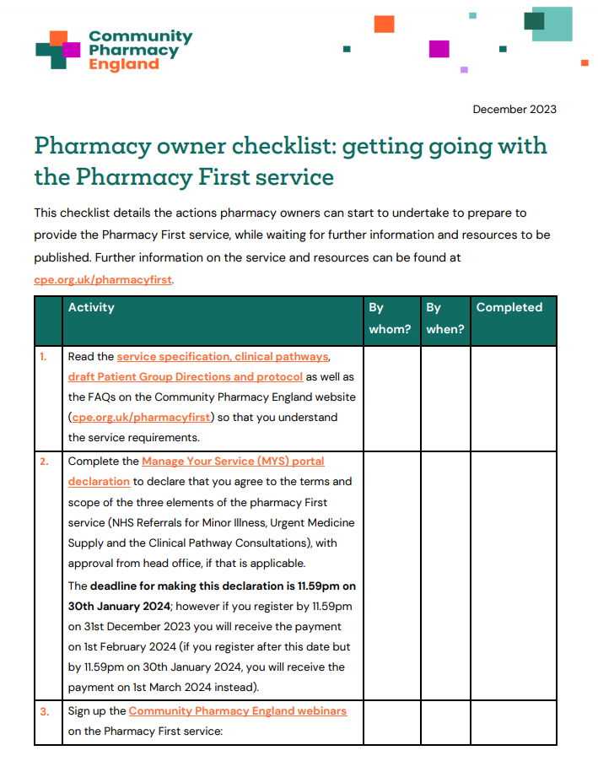
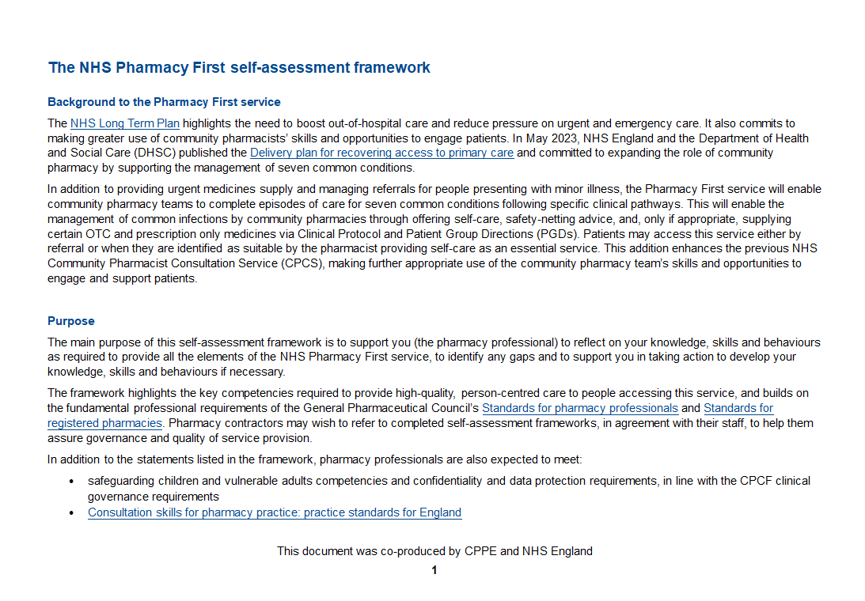
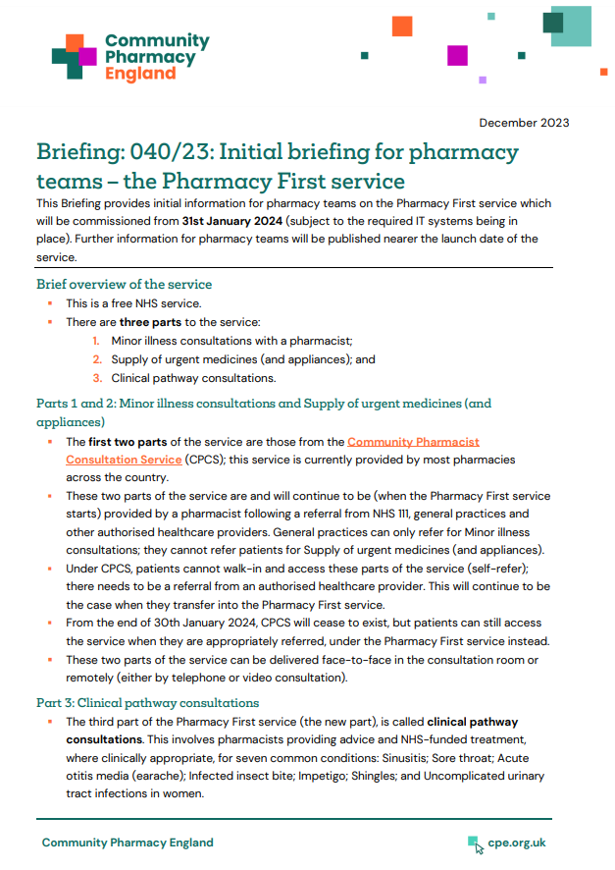
Resources to help you get ready
Checklists of things to do to prepare for the service for pharmacy owners and pharmacists​
The CPCS toolkit is being updated to cover the new service​
CPPE Pharmacy First webpage and self-assessment framework​
Cliniskills training modules and locally organised training options​
Summary briefing for pharmacy team members

Slide 26
Promoting the service
NHS England is developing a marketing campaign for the service
Briefing to Local Medical Committees and general practices about the service
A briefing for LMCs and general practice teams is available at cpe.org.uk/pharmacyfirst
NHSE developing practice toolkit
Pharmacy teams to talk to local practices
Further resources are being developed by Community Pharmacy England to help you and LPCs to promote the service to patients, the public and local stakeholder organisations

Slide 27
Questions cpe.org.uk/pharmacyfirst

Slide 28
Pharmacy First “Making Every Contact Count”

Slide 29
Making Every Contact Count or Maximising Income
Referrals
GPCPCS
NHS 111
Acute Presentations
Patient Self-Refers
Patient Recruited in the Pharmacy
Follow Up & Safety Netting
Onward Referral
Pharmacy Follow Up
Patient Journey
Pharmacy Staff Involvement
Closing the consultation & safety netting

Slide 30
Patient Journey
In Pharmacy Recruitment
OTC Purchase converted to a PF Consultation
Till Markers & Messages
Margin OTC vs Consultation
Advertising in the pharmacy
“up selling”
Patient Clerking – pre-loaded into Pharmoutcomes & by whom?
“Partial Save” of Consultation
Staff Roles & Responsibilities in the patient journey – work as a team
System Access
External Referral
Self-Referral
Pharmacy Recruitment

Slide 31
Patient Journey
Sinusitis (Over 12yrs)
Sore throat (Over 5yrs & FeverPain Score >3)
Earache (Over 1yr but Under 18yrs)
Infected insect bite (Over 1yr & Adult)
Impetigo (Over 1yr & Adult)
Shingles (Over 18yrs)
Urinary tract infections in women (uncomplicated between 16 & 65 yrs)

Slide 32
Uncomplicated UTI – 45yr Old Female
NEWS2 Observations
Is the patient confused
Temperature
Pulse
O2 Sats
Opportunity to provide the BP service.
Respiration Rate
Test Urine with Multistix GP (Leucocytes, Nitrites, Blood - explain the results, would give you at least 2 symptoms)
What’s the Score – Any Concerns?
Check PMR / SCR for any relevant medication
Safety Netting and Onward Referral (if referring on send the NEWS2 Obs and Dipstick Results)
Have you passed the “gateway” for a claim?

Slide 33
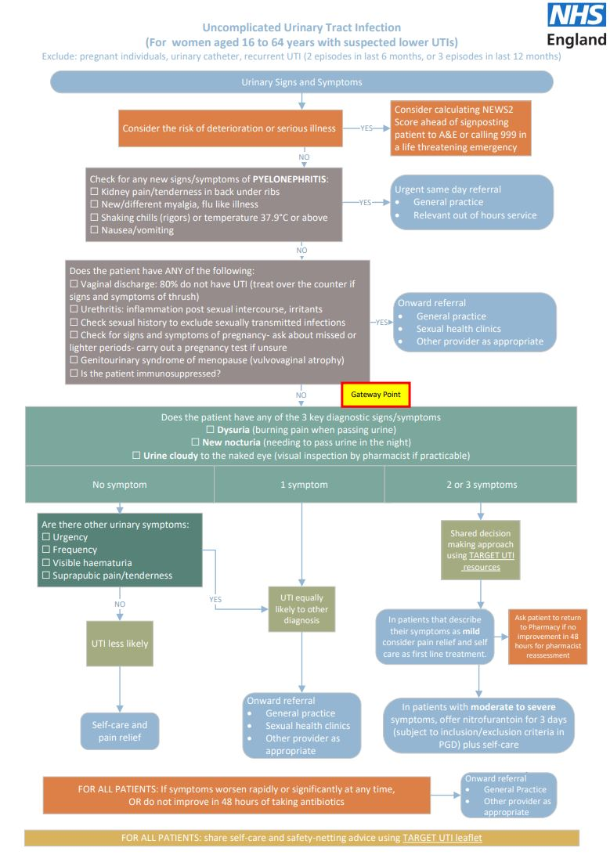

Slide 34
Uncomplicated UTI – 45yr Old Female
Potential Income
GPCPCS or Pharmacy First?
Is it appropriate to defer treatment?
Can you treat them separately?
Is there an opportunity to provide the BP service?
Possible Oral Contraception Supply?
Minimum Income - £30 (£15 PF and £15 BP plus POM supply)
Safety Netting and Onward Referral – NEWS2 Obs
Repeat consultations as service is personal and efficient
Follow up with AccuRx Text

Slide 35
Sore Throat
NEWS2 Observations
Is the patient confused
Temperature
Pulse
O2 Sats
BP
Respiration Rate
FeverPain Score (Onset, Pustules, Severity, Fever)
What’s the Score – Any Concerns?
Check PMR / SCR for any relevant medication
Safety Netting and Onward Referral (if referring on send the NEWS2 Obs and FeverPain Score)
Have you passed the “gateway” for a claim?

Slide 36
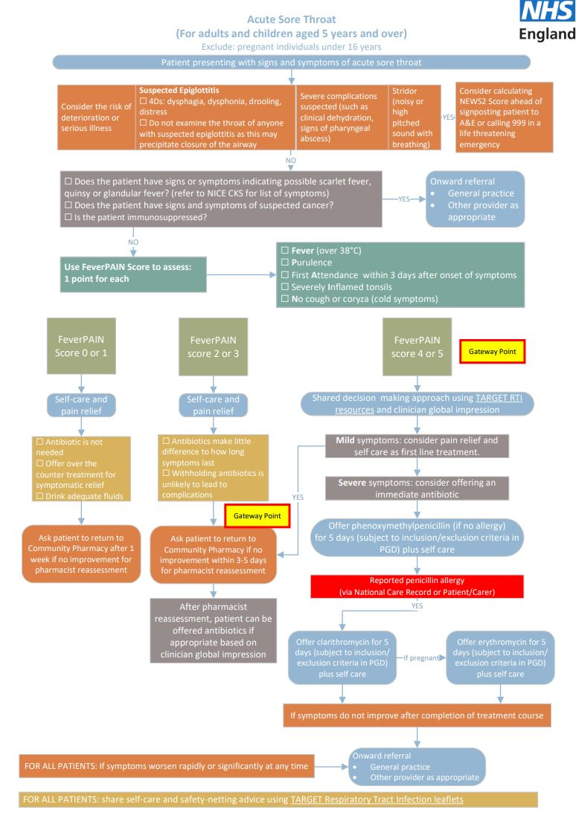

Slide 37
Sore Throat
Potential Income
GPCPCS or Pharmacy First?
Is it appropriate to defer treatment this could generate a further claim under Pharmacy First?
Can you treat them separately?
Is there a BP Clinic Check opportunity?
Possible Oral Contraception Supply?
Minimum Income - £30 (£15 PF and £15 BP plus OTC sale or POM supply)
Safety Netting and Onward Referral – NEWS2 Obs & FeverPain
Repeat consultations as service is personal and efficient
Follow up with AccuRx Text

Slide 38
The key is providing an excellent patient experience

Slide 39
The Pharmacy First patient journey

Slide 40
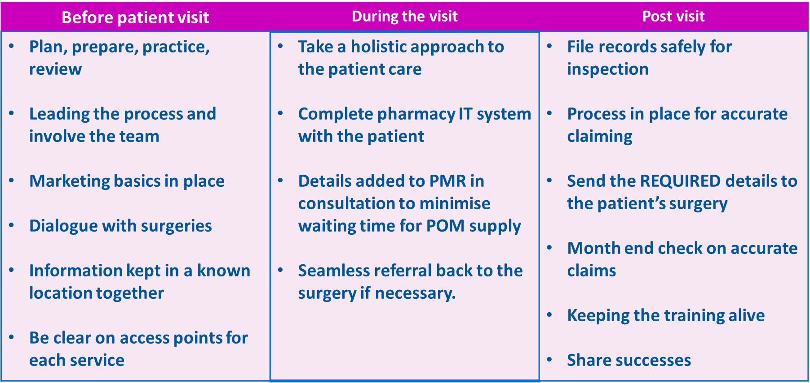
The patient journey

Slide 41
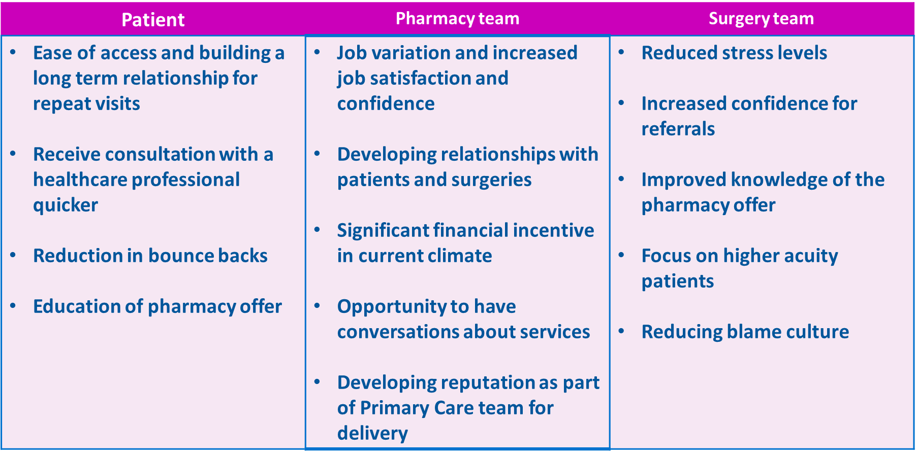
Who benefits?

Slide 42
Key Dates & Resources

Slide 43
Key Dates
Action | Deadline
Current CPCS finishes | 30/1/24
Pharmacy First commences plus de-registration of CPCS if contractors not signed up to Pharmacy First | 31/1/24
Last date to sign up for Pharmacy First and receive £2000 payment | 31/1/24
Deadline to deliver at least 5 qualifying PF pathway consultations | 31/3/24
Current extended care services decommissioned | 31/3/24
Deadline to opt in to the upgraded contraceptive service offering tier 1 and tier 2 or pharmacies will be de-registered | 29/2/24
Bp and OC services will become part of the PF service | 31/3/25

Slide 44
Key Dates - IT
Action | Deadline
To ensure you are “live” on Directory of ServiceS (DoS) to receive referrals by 31st January 2024. Sign up to Pharmacy First Sign up to a supplier; or Switch providers | 19 January 2024
The DoS team WILL NOT action any supplier switches between 22 and 24 January | 22 January – 24 January 2024
Pharmacies receive referrals from 111 online and 111 telephony Patients are signposted from NHS Service Finder and Find a Service on NHS.UK | 31 January 2024

Slide 45
Resources
Pharmacy First Advanced Services Specification
Suite of PGD’s
Nottinghamshire LPC – Representing pharmacy contractors in Nottinghamshire (communitypharmacy.org.uk)
Derbyshire LPC – Supporting Derbyshire's Pharmacies (cpderbyshire.org.uk)
Pharmacy First service - Community Pharmacy England (cpe.org.uk)
NHS Pharmacy First service : CPPE
Community Pharmacists | CliniSkills
Midlands Community Pharmacy Integration - FutureNHS Collaboration Platform (LOG IN REQUIRED)
January 2024 Committee Opinion Poll - Independents and Non-CCA Multiple Survey (surveymonkey.com) (DEADLINE 21ST JAN)

Slide 46
LPC Support
Weekly Pharmacy First Contractor Drop in sessions via Microsoft Teams – every Monday 2-3pm. These are Notts/Derbyshire/Lincs wide calls. Please contact Alison Ellis for the link.
Further information evening events late Spring/early Summer as needed. A poll will be sent out to ascertain if they are.
Resources on websites
Visits to pharmacies by the LPC Operations Team to those pharmacies not signing up or not delivering the required levels of activity to avoid clawback.
If you think that there are any others ways to support then please let us know!!

Slide 47
Keeping in touch - Derbyshire
Nick Hunter, Chief Officer nickhunter@derbyshirelpc.co.uk
Amanda Alamanos, Engagement Lead amanda@derbyshirelpc.co.uk
Chris Kerry, Service Implementation& Support Manager chriskerry@derbyshirelpc.co.uk
Alison Ellis, Secretary – AlisonEllis@cpnotts.org
Shazia Patel, Community Pharmacy Clinical Lead, NHS Derby & Derbyshire ICB shazia.patel@nhs.net

Slide 48
Keeping in touch - Nottinghamshire
Nick Hunter, Chief Officer – Nickhunter@cpnotts.org
Mike Jones, Service Implementation and Support Officer Mikejones@cpnotts.org
Alison Ellis, Secretary – AlisonEllis@cpnotts.org
Rebecca Dickenson, Community Pharmacy Clinical Lead, NHS Nottingham & Nottinghamshire ICB Rebecca.dickenson7@nhs.net

